Slide 1














Accelerating the digital transformation of government services
Notes:
Kate 3 minutes –
Introduction David Hani Marten

Slide 2
Project Overview
Title:
Co-funded by: The European Commission and the German Federal Ministry for Economic Cooperation and Development
Duration: 01/2022 - 03/2025, Implementation Phase: 07/2022 - 02/2025
Project Partners: GIZ, Expertise France (EF) & International and Ibero-American Foundation for Administration and Public Policies (FIIAPP)
Objective: Support selected countries to implement digital government services based on the GovStack approach and improve national and regional cybersecurity in the region.
Components:
Digital Government (GIZ/FIIAPP)
Cybersecurity (EF)
Partner Countries:
Implementing Partners: International Telecommunication Union (ITU), Digital Impact Alliance (DIAL), Estonian Centre for International Development (EstDev)

Slide 3



Digital Government: Focus Areas
Strategy
Digital Government Strategy and Roadmap Development
Evaluation of the strategic, technical and regulatory prerequisites to introduce government e-services.
Technical Design
Technical specification and design of e-government service use case
Technical design and proof of concept on how a use case could be implemented using the building block approach.
Capacity Strengthening
Capacity strengthening for digital government
Strengthen the technical and methodological skills of civil servants to implement e-government services

Slide 4







Digital Government: Project Activities
Digital Government Strategy and Roadmap Development:
Evaluation of the strategic, technical and regulatory prerequisites to introduce government e-services.
Action Area 1:
Strategy Development
Activities
Needs Assessments
Strategy formulation
Roadmap development
Implemented by

Slide 5
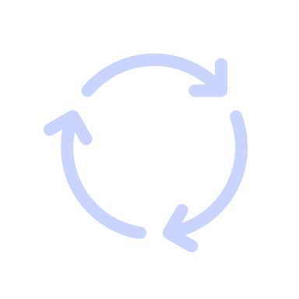


Digital Government: Project Activities
Technical specification and design of e-government service use case:
Technical design and proof of concept on how a use case could be implemented using the building block approach.
Action Area 2:
Technical Design
Activities
Adapt relevant Building Blocks to the identified services
Select public services which the Building Blocks can help digitize
Pilot the relevant Building Blocks for the selected public services
Implemented by

Slide 6





Digital Government: Project Activities
Capacity Strengthening:
Strengthen the technical and methodological skills of civil servants to digitize government services.
Action Area 3:
Capacity Strengthening
Activities
Training on e-government building blocks
Training on change management (transition from analog to digital)
Communities of Practice for peer-to-peer learning
Implemented by

Slide 7



The next two years will focus on the following activities
 | Major Strategic Areas |  | Goal
1 Specify | Develop and evolve specifications for high-priority Building Blocks, and a Blueprint for an illustrative digital government service that uses them |  | Create technical reference pieces of generic digi. gov enabling components
2 Demonstrate | Invite product / approach demonstration and develop working reference models of the illustrative stack showcasing applicability of digital services, guided by specification outputs from Phase I (Building Blocks and Blueprint) |  | Show how the GovStack approach can employ a set of cross-sector, interoperable, secure and integratable Building Blocks to demonstrate delivery of a pipeline of digital services
3 Apply | Engage pilot countries to inform approach in their larger digital government strategy effort and implementation roadmap, and sustain ongoing advocacy and address country capacity needs |  | Ultimately inform national digi. gov strategy drawing from proposed approach + diff. reference models in their transformation journey

Slide 8
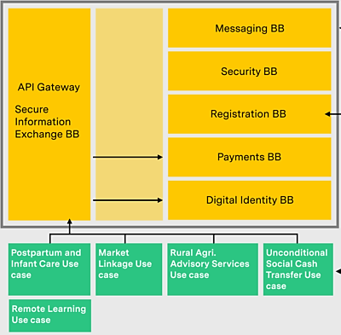
The next two years will focus the following roadmap…
Refer to details at Our Solution area of the GovStack website.
Specifications of various interconnected Building Blocks.
PHASE iii:
Platform
Phase ii: Procurement
Architecture blueprint
Business requirements and technical specifications for 10-12 Building Blocks
Accompanying open API conditions
OUTPUTS
Launch and execution of procurement tender to solicit service in delivering a first GovStack model
Starting w. survey market capabilities: see RFI call
OUTPUTS
OUTPUTS
Functional software environment demonstrating models / approaches to implementing GovStack by addressing multiple cross-sectoral use cases
Guidance and manuals for reuse
Repurposed resources from procurement effort into references to support similar exercise in partner countries
Phase i: Reference(s)
Living platform with reusable solutions illustrating reference implementations of the GovStack model that support multiple use cases, starting with the 5 listed.

Slide 9

What is next? Indicative Workplan
INCEPTION PHASE
IMPLEMENTATION PHASE
Q1
Q2
Q3
Q4
Development of 3 Technical Training Modules
Overall Project
Official Project Kick-off
Identification of 5 e-Government Services
Output 1: Strategy
Validation Workshops
Development of 3 National Roadmaps
Output 2: Technical Design
Launch of 3 Country Working Groups
Output 3: Capacity Strengthening
Prioritisation Workshops
Country Missions
We are here
Concept for 3 Technical Training Modules
Consultation Workshops & Stakeholder Mapping
Country Profiles
January
March
April
May
June
July
August
September
October
November
December
February
2021
2023
Contract Signing

